Slide 1


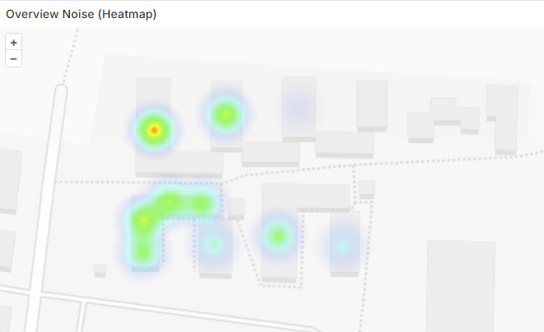
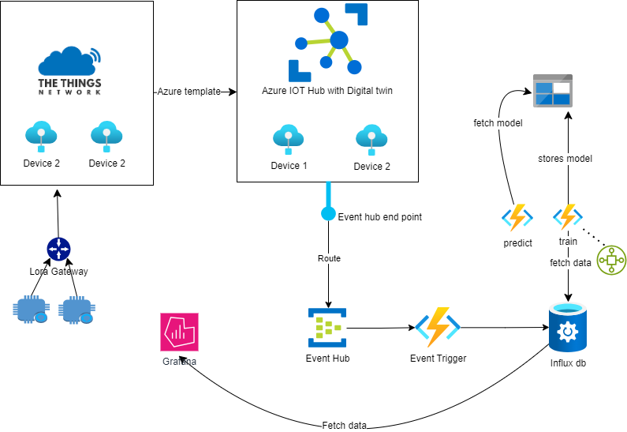
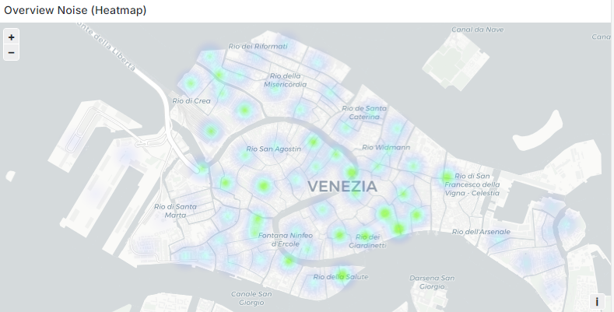
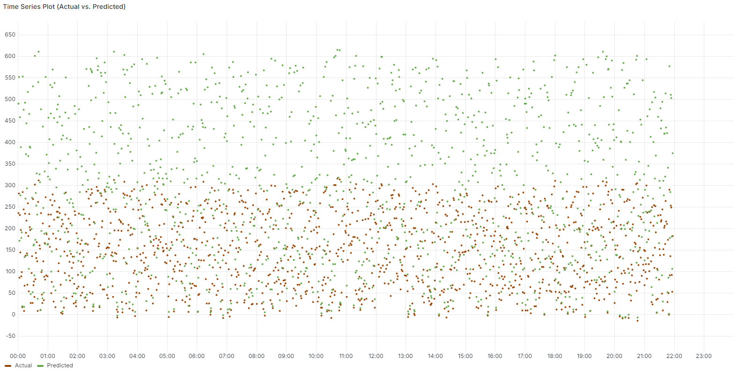
Internet of Things (IoT)
NoiseTrackr :
Silence is Golden
Motivation
Touristic cities suffer from overtourism and environmental problems (such as noise pollution).
Some cities suffer from gun violence and gang related incidents. Police and Forensic personnel like to have information such as when a gun was fired for investigation purposes.
Housemasters and Universities like to identify which block or apartments are causing noise and at what time of the day.
Team NoiseTrackr
Gabriel Witte
Luiza Landinger
Saruni Fernando
Tafara Warren Machiridza
Victor Owolabi
Results
Goal
An application which
Analyse and monitor the amount of noise generated at different regions within a different timeframes.
Architecture
Heatmap representation of the student apartments
Architecture of the setup
Heatmap representation of the data on Venice
MVP
Receive noise insights through graphs and time-series + bar charts.
Users can select the timeframe for their analysis.
Users may select one or multiple regions at a time for analysis.
Users have access to ML methods to forecast future noise in the selected regions.
Users can be alerted if a selected region exceeds a predefined noise level.
Time series representation on actual vs predicted data
Fakultät für Informatik
FWPM „Internet of Things (IoT)“ - Bachelor
Prof. Dr. Marcel Tilly

